Slide 1
Technologies

Slide 2
As for technologies, please avoid usage of any other technologies/libraries, than the ones below:
HTML
CSS (SCSS allowed, but don’t use any CSS framework like Tailwind, etc)
BEM for CSS is required (it’s easy to learn in case you are not familiar with it)
Vue
Vuex

Slide 3
General

Slide 4
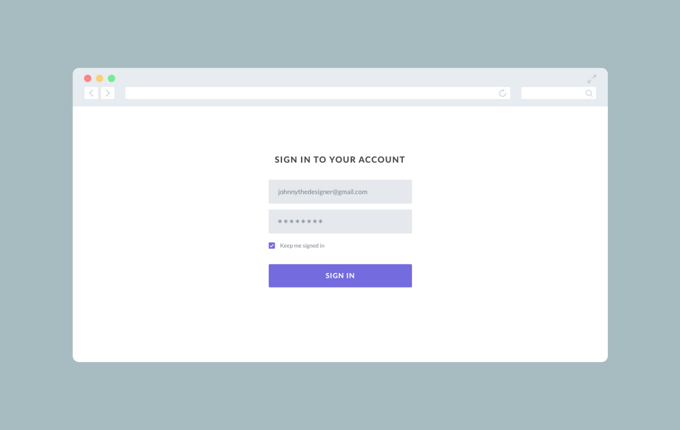
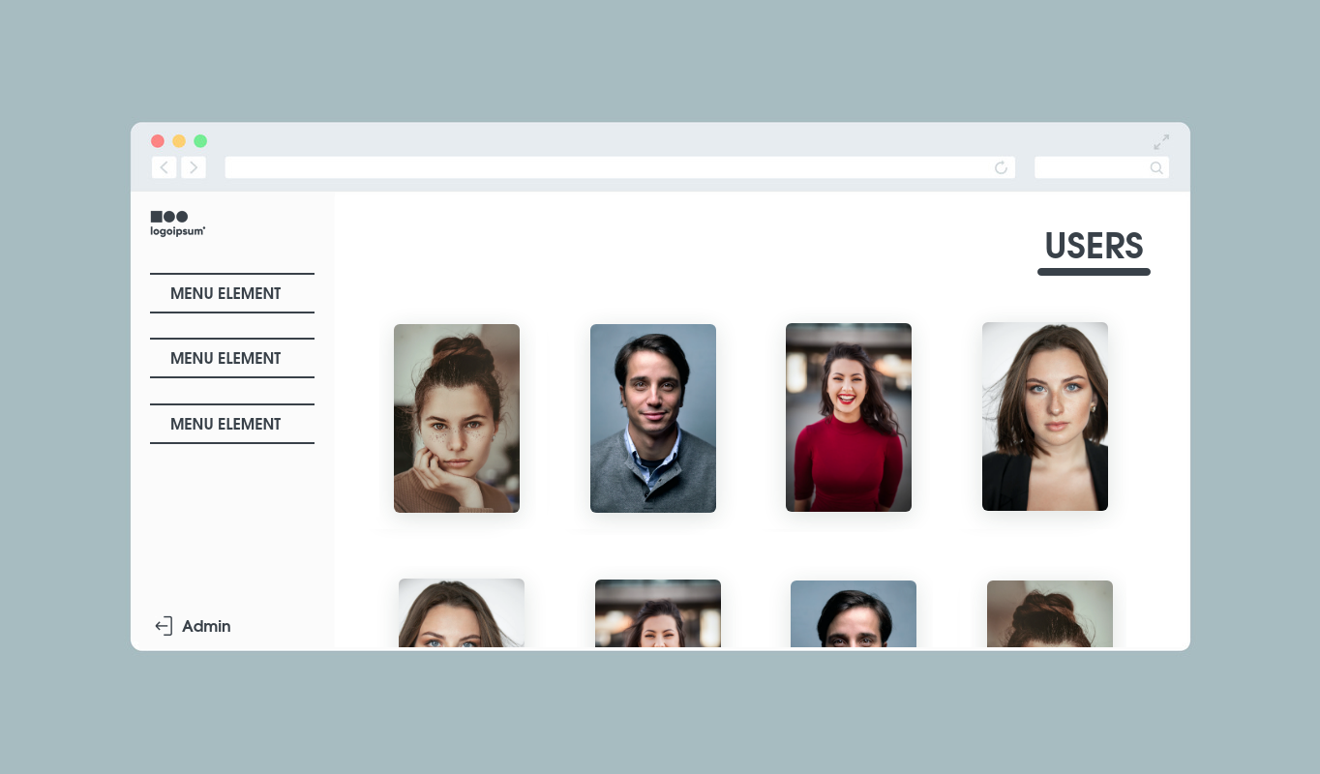
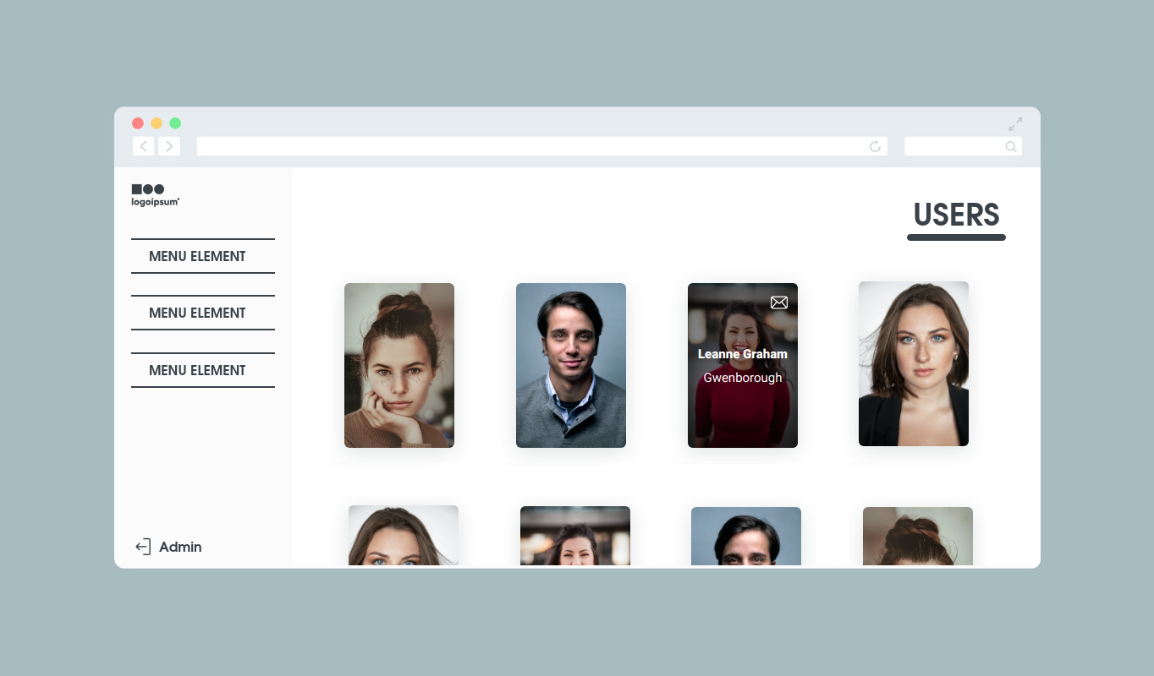
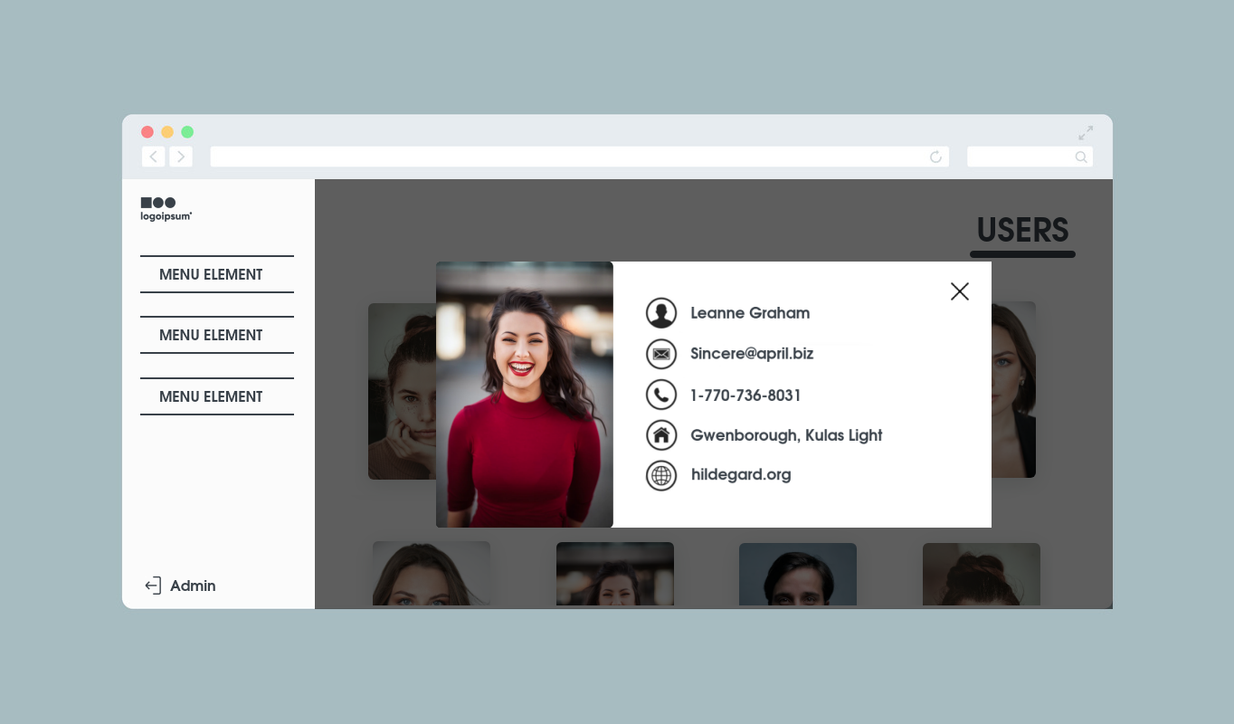
If unauthenticated user visits the website, he should see this screen (“website/login”-page). User should be able to log in with username: “admin” and password “1234”. If he has entered any other combination - front-end should show an error (preferably a notification, which would automatically hide after e.g. 5 seconds). Once right credentials were entered, front-end should automatically redirect user to “website/users”-page, which has to look like this.
The list of users could be get with “GET /api/users”-request. Please implement any appearing animation for those cards.
On hover over a card, it’s UI should change to this state.
On click on card, this modal should appear.
Entire UI has to be responsive for screens with minimal width of 320px.
IMPORTANT
UI showed here is just a prototype. You are free to do anything you want: custom animation, fancy cards or anything else - you have no limits in terms of UI (it just has to look good). Better look means higher rate of your result.
/api/users:
Please save this json https://docs.google.com/document/d/14WHI45SUwdXpN7iOQvqnyPUT1D8E13fw83a9CVw12hE/edit?usp=sharing to your developement directory and send it as a response for GET /api/users
You must fetch and show the users in the server side.

Slide 5
Explanation of UI

Slide 6
This is the area you have to deal with. Don’t mind everything outer.

Slide 7
user.image
Just a placeholder
Click on this should log user out
This content becomes visible once user scrolls down

Slide 8
user.name
user.address.city

Slide 9
Click on this should open default mail program, create new message with subject “We are hiring!” and body “Hello, user.name. We’d like to propose you an offer.”
Click on the button, or anywhere outside the modal should close the modal
user.name
user.email
user.phone
user.address.city,
user.address.street
user.website

Slide 10
Submitting the result

Slide 11
Once you are done, please publish your work into a separate GitHub-repository (make sure that it is visible for everyone) and deploy the result on live so that it could be checked by anyone in the Internet (either with any of these approaches:
GitHub pages
Netlify
Heroku
; or in any other way).
To submit your work please attach:
2 screenshots of live result (“website/login”-page and “website/users”-page)
a link to live deployed result
a link to GitHub repository
approximate time spent on the task.

